Slide 1
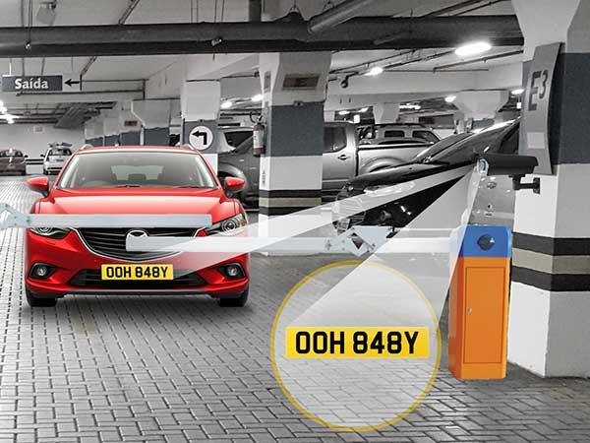
Recognition of Vehicle Plate
Submitted to: Dr. RamPrakash
Submitted by: Group 4

Slide 2
OBJECTIVES
This project will be really useful in automating the world and reducing pressure on the human workforce on putting manual efforts to strain their eyes and recognise the number plate with automated programs.
The main objective of number plate recognition is to ensure that traffic rules are not violated.
It can also be used for charging parking tickets in malls, restaurants or for municipal corporations.
We can also use it to identify the stolen vehicles recognising their number plates making it less hectic for the police force.

Slide 3
LIBRARIES USED
FOR IMAGE ENHANCEMENT AND PROCESSING
Numpy
Open CV
Matplotlib
FOR CHARACTER RECOGNITION
Pytesseract

Slide 4
Elements for Recognition of Vehicle Plate
Vehicle Plate Recognition system consists of Three main modules:
Image Preprocessing
Extraction of Vehicle Plate Region : Canny Edge Detection Algorithm
Optical Character Recognition

Slide 5
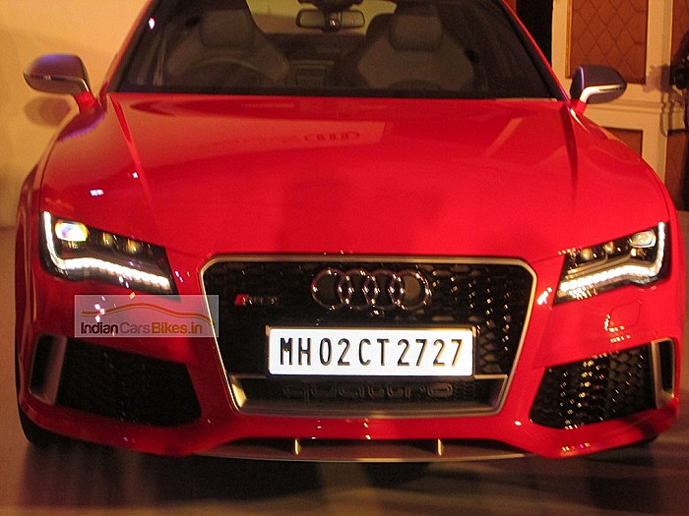
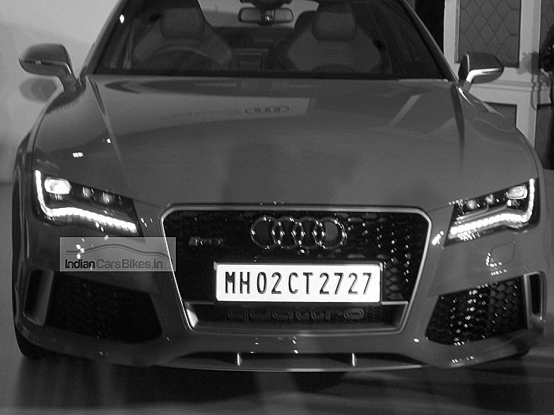

Image Preprocessing
Image Sharpening
Conversion to gray scale
Applying bilateral filter for smoothing

Slide 6
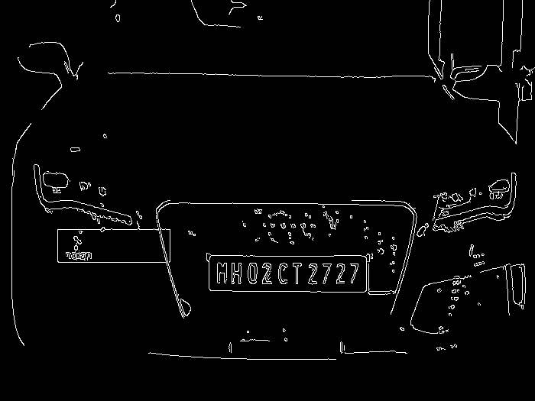
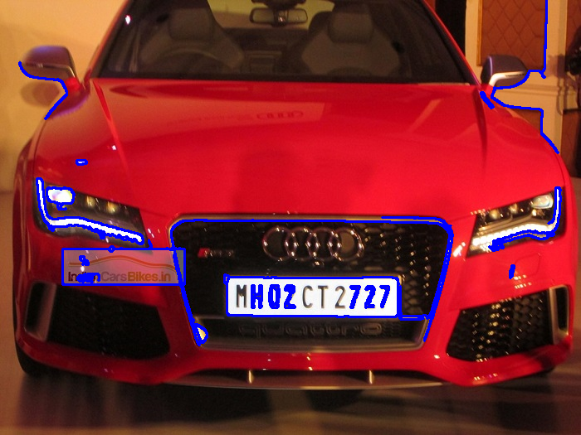
Extraction of Region Plate
Canny Edge Detection to get the edges
Now start finding contours , also we will sort the counters that have been detected and will look a counter having four sides and closed figure.

Slide 7
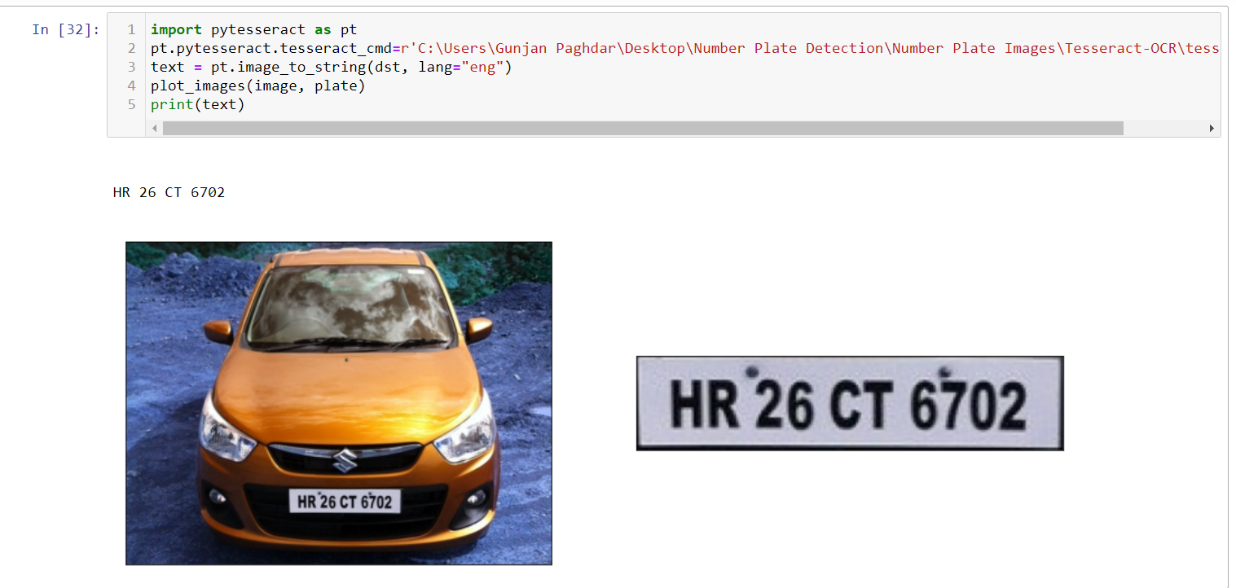
OPTICAL CHARACTER RECOGNITION
Now we will read characters from image using ‘pytesseract’ package.
And finally we can find and print the text extracted from vehicle plate.

Slide 8
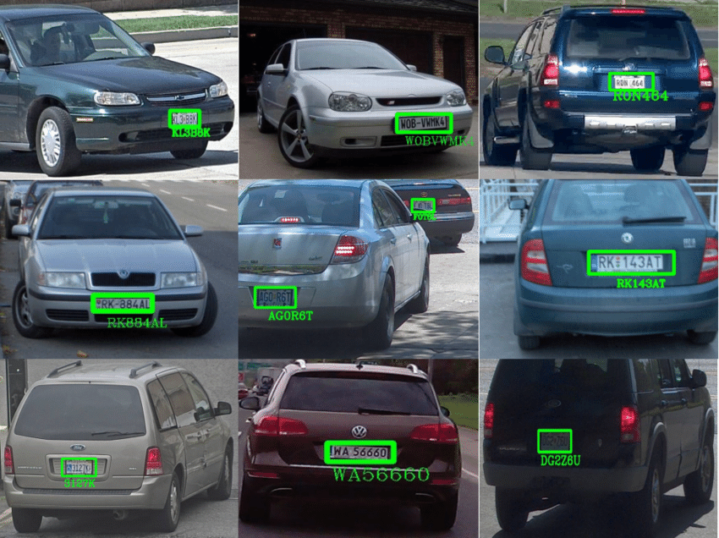
THANK YOU
Group 4 Members :
Shwet Khatri 19dcs001
Amit Gupta 19ucs011
Gunjan Paghdar 19ucs101
Manan Gandhi 19ucs130
Kush Gandhi 19ucs131

